Slide 1

An innovative solution for car rental and driver booking system
Ali Ahmed
Shaheer Mehmood
Shayan Ahmed

Slide 2
Introduction
Our project develops a car rental and driver booking app, offering a reliable and convenient platform for users to rent cars and hire professional drivers.
GoDriver revolutionizes car rental and driver booking with seamless features: search, book vehicles, and request professional drivers.

Slide 3
System Design
Our application will adopt the MVC architecture
It will be organized into different layers with different functionalities to ensure that the application will be modular ,scalable and easy to maintain.
The user interface will be intuitive and built using modern design patterns to ensure a smooth and responsive user experience.

Slide 4
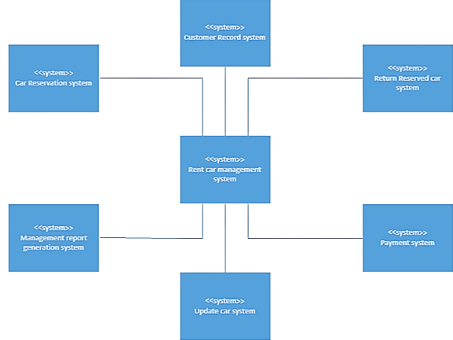
System Architecture

Slide 5
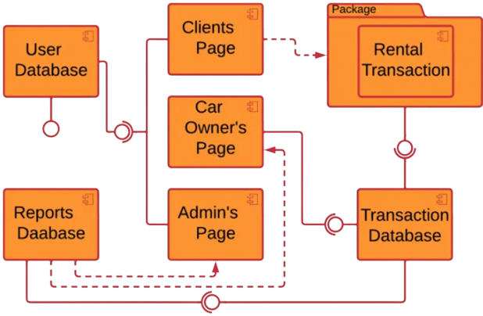
Component Diagram

Slide 6
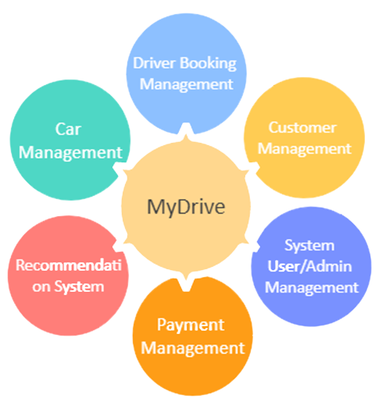
System Level Architecture

Slide 7
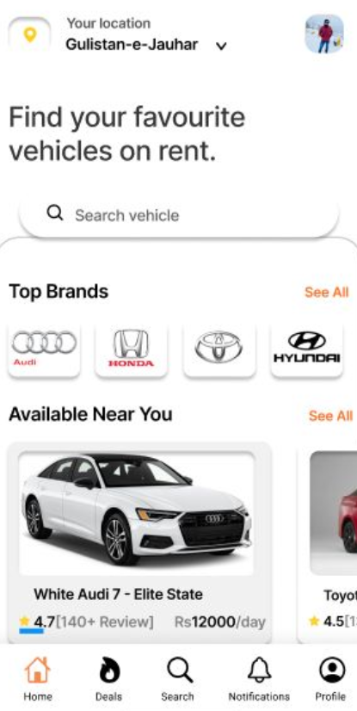
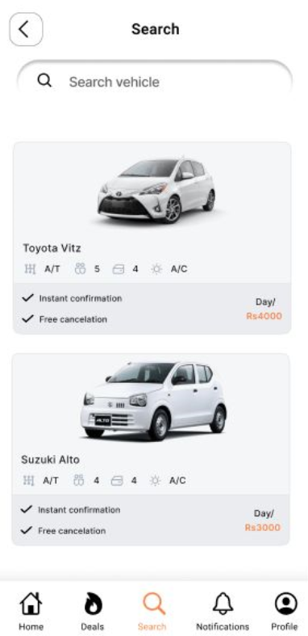
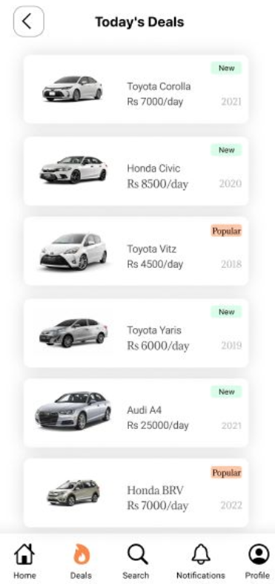
User Interface

Slide 8
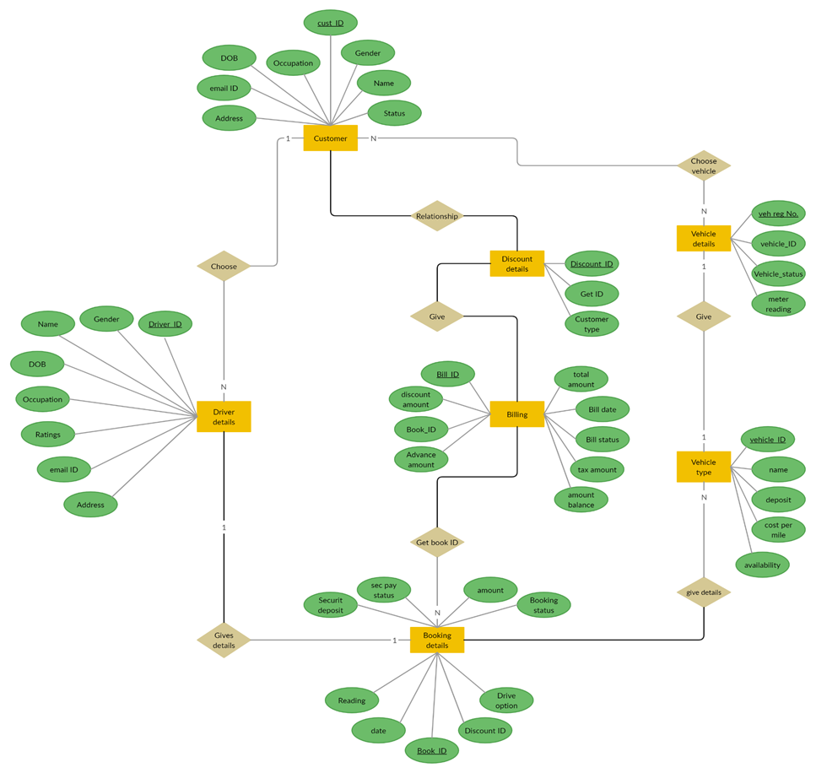
Database design

Slide 9
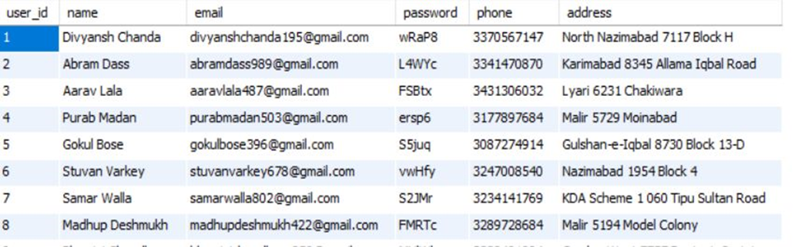
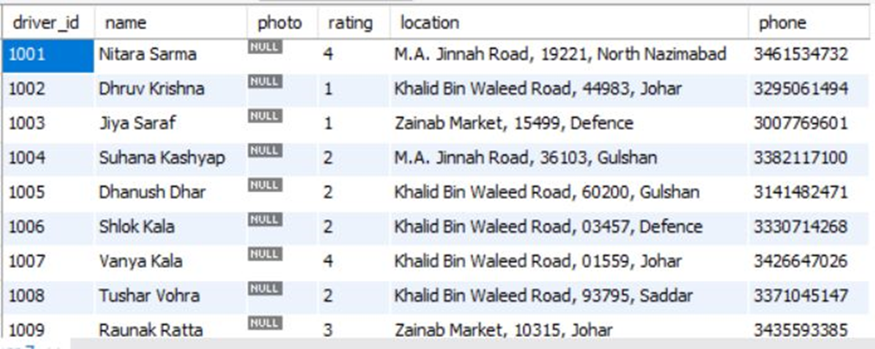
Sample Data

Slide 10
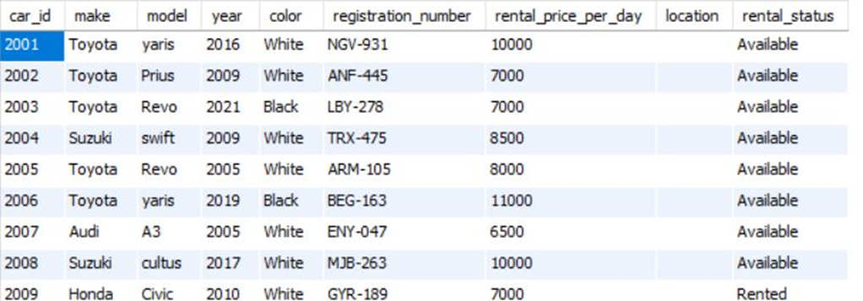
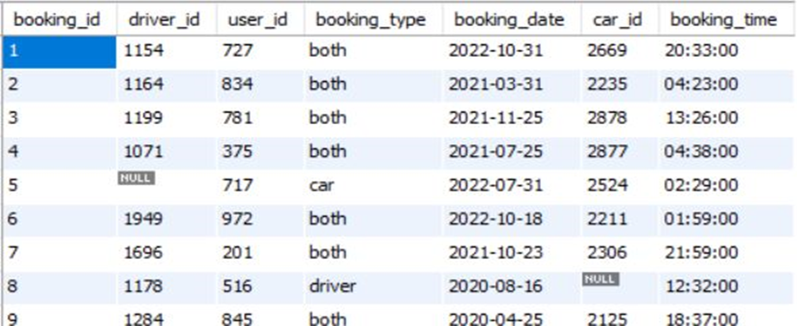

Slide 11
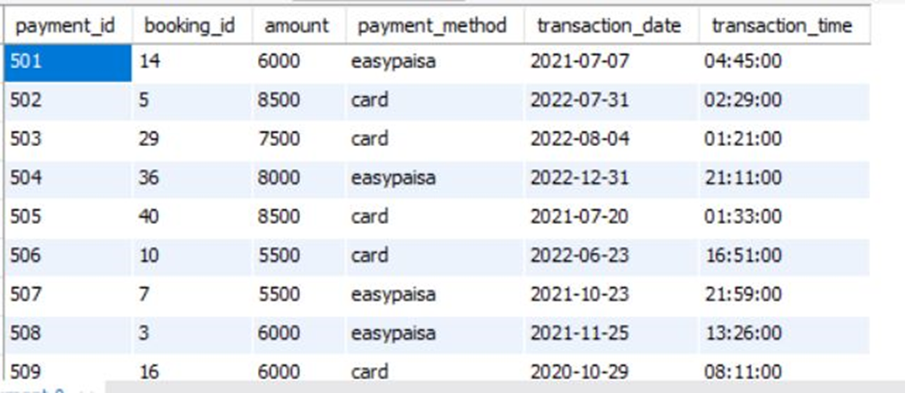

Slide 12
Thank you

